Slide 1
Atlas
GROUP ATLAS
Google Calendar
Microsoft Teams/Outlook
Canvas
One calendar for your whole schedule, with an AI assistant that helps you plan it.
Apple Calendar
Athar Ahmad · Abel Tolla · David Worku · Nader Abouelregal · Kero Shafik
Notes:
Welcome everyone. We are Group Atlas, and this is our calendar project. We will cover the problem we noticed, what Atlas is and what the MVP includes, the smart features, our system sketch, and finally the value to users and what comes next.

Slide 2
Schedules scattered across apps
THE PROBLEM
Canvas
Google Calendar
Microsoft Teams/Outlook
Apple Calendar
Class assignments and deadlines
A part-time job and personal plans
Personal appointments
Club meetings and workplace calendars
Switching between them leads to missed deadlines and accidental double-bookings, and moving events by hand takes time.
Atlas
Intro and the problem
Notes:
Many people keep their schedule in several places at once. A student can have assignments in Canvas, a part-time job on Google Calendar, club meetings in Microsoft Teams, and personal appointments on Apple Calendar. Professionals do the same with a corporate Outlook calendar next to a personal Google one. Switching between apps leads to missed deadlines and accidental double-bookings, and it means copying events by hand.

Slide 3
One calendar for every source
PRODUCT DESCRIPTION
SOURCES COMBINED
Google Calendar
Atlas is a web-based calendar application that brings a user's entire schedule into one place.
Microsoft Teams/Outlook
Canvas
Classes, meetings, assignments, appointments, and personal events sit side by side, so nobody has to switch between apps.
Apple Calendar
Color-coded by where each event came from
Atlas
Product description and MVP
Notes:
Atlas is a web-based calendar that pulls events from Google Calendar, Microsoft Teams/Outlook, Canvas, and Apple Calendar into one view. Each event is color-coded by its source, so a user can tell at a glance whether something came from class, work, or personal life.

Slide 4



The MVP scope
MVP
Unified calendar
Two or more sources
Basic AI assistant
One view for classes, meetings, assignments, and personal events.
Connect at least two of the four sources: Google Calendar, Microsoft Teams/Outlook, Canvas, and Apple Calendar.
Reads schedule information and performs simple task actions.
Atlas
Product description and MVP
Notes:
For the MVP we are keeping the scope small. First, the unified calendar itself. Second, connections to at least two of the four calendar sources. Third, a basic AI assistant that can read schedule information and perform simple task actions.

Slide 5

An assistant that knows the schedule
SMART FEATURES: AI ASSISTANT
"What should I work on right now?"
IT CAN
Answer questions about availability
Find open time slots
"Can I finish this assignment before Friday?"
Create and reschedule events
Break a large assignment into smaller work sessions, scheduled around existing commitments with one click to approve
Atlas
Smart features
Notes:
The assistant understands the user's schedule. Students and professionals can ask practical questions, like what to work on right now or whether an assignment can be finished before Friday. It can find open time slots, help create or reschedule events, and split a large assignment into smaller study or work sessions. The user approves the plan with a single click.

Slide 6

Conflict handling by priority
SMART FEATURES: SCHEDULING
TWO EVENTS OVERLAP
ATLAS RESOLVES IT
Medical appointment
Medical appointment
High priority
Stays on the calendar
Baseball game
Baseball game
Lower priority
Moves to another time
The goal is for Atlas to detect overlapping events on its own and use priority and importance to decide what shifts.
Atlas
Smart features
Notes:
The second smart feature is scheduling. Our goal is for Atlas to detect overlapping events automatically and use priority and importance to decide what moves. For example, a medical appointment should take precedence over a baseball game.

Slide 7
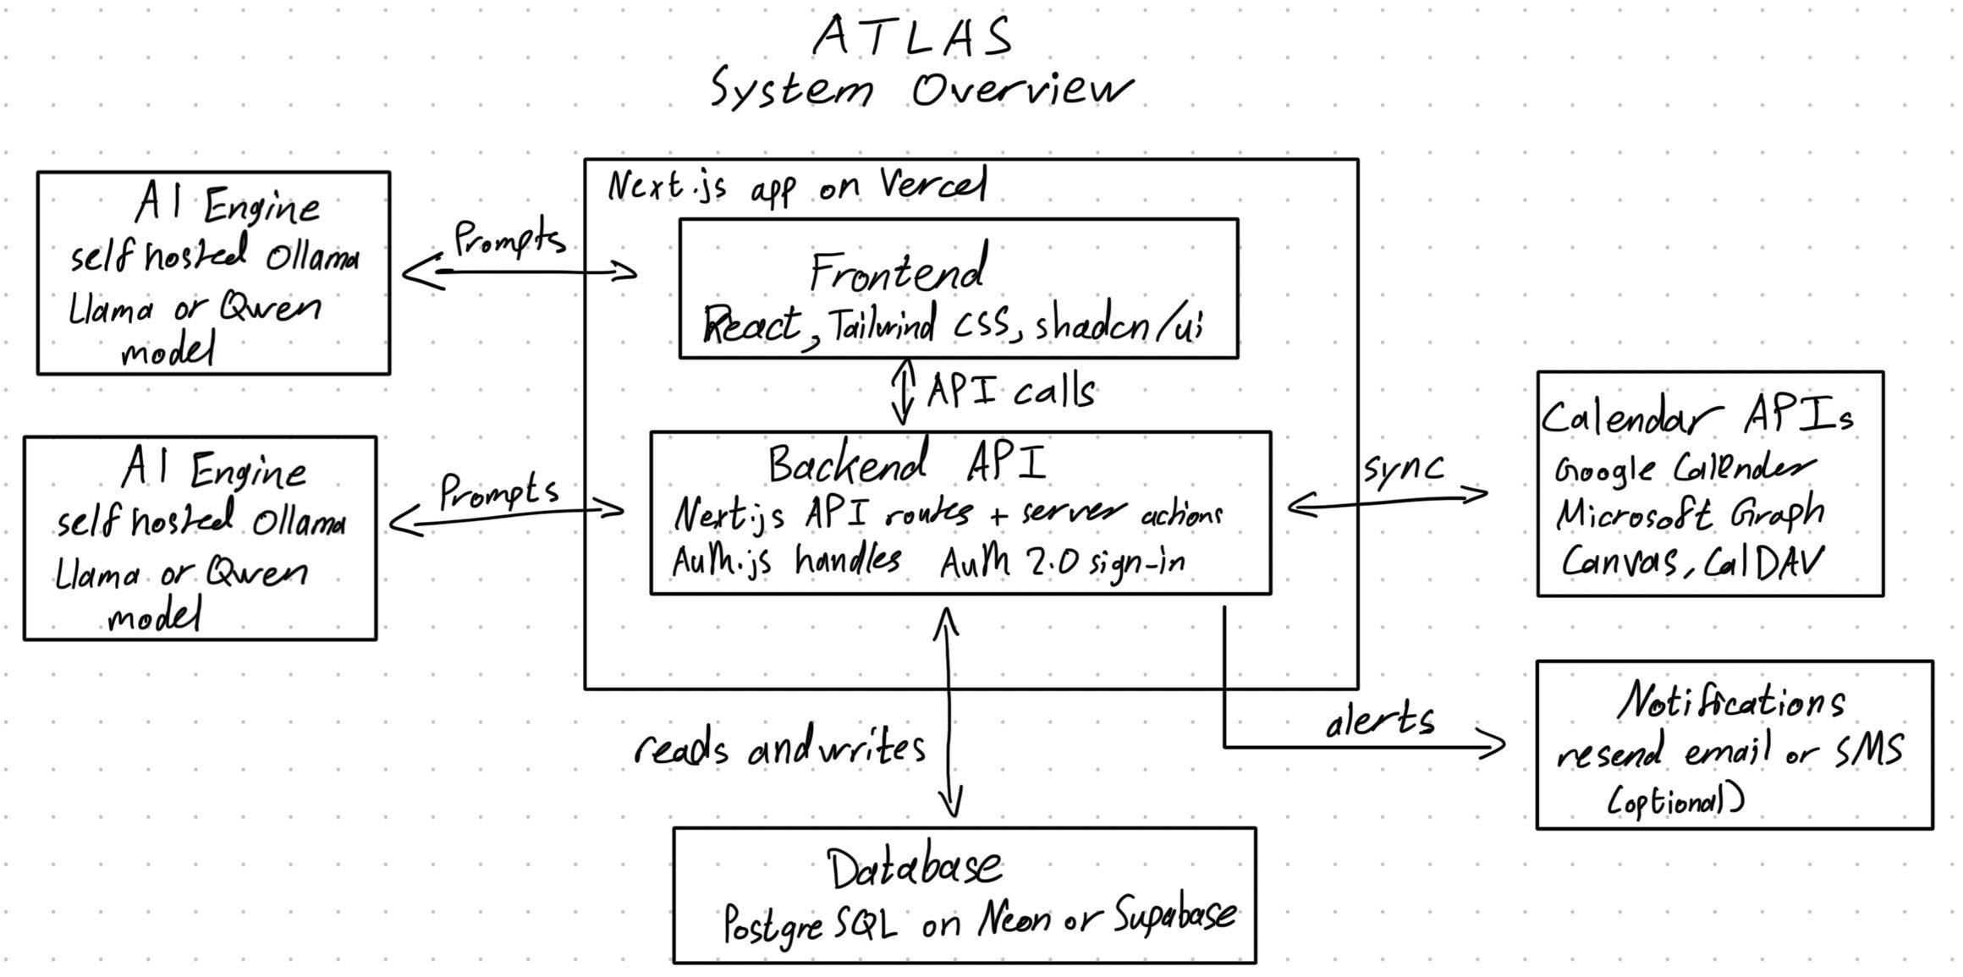
System overview
THE SKETCH
Atlas
The sketch
Notes:
This is our system sketch. Everything runs in one Next.js app on Vercel, with the React frontend and the backend API together. The backend syncs with the calendar APIs, reads and writes the PostgreSQL database, talks to a self-hosted Ollama server for the AI assistant, and sends alerts through email or optional SMS.

Slide 8
System components
THE SKETCH
Frontend
Backend
Calendar sync
React, Tailwind CSS, and shadcn/ui for the calendar view, task pages, and AI sidebar.
Next.js API routes and server actions on Vercel. Auth.js handles OAuth 2.0 sign-in.
Google Calendar, Microsoft Graph, the Canvas API, and CalDAV pull in events and keep them current.
Database
AI engine
Notifications
PostgreSQL on Neon or Supabase, read and written by the backend.
Self-hosted Ollama running Llama or Qwen. The backend sends only the relevant part of the schedule.
Resend email for reminders and deadline warnings, with optional SMS.
Atlas
The sketch
Notes:
Walk through each box. The frontend is what users see: the calendar, the task pages, and the assistant sidebar. The backend uses Next.js API routes and server actions, with Auth.js handling OAuth 2.0 sign-in. Calendar sync uses Microsoft Graph, the Google Calendar API, the Canvas API, and CalDAV for Apple Calendar. Data lives in PostgreSQL on Neon or Supabase. For the assistant, the backend sends the prompt plus only the relevant part of the user's schedule to an Ollama server running Llama or Qwen. Notifications go out through Resend email, with SMS as an option.

Slide 9



Time saved and less stress
VALUE TO USERS
Built for students and working professionals balancing a busy schedule.
One unified view
Active planning
Staying informed
Classes, meetings, assignments, and personal events together, color-coded by where each came from.
Atlas finds open slots, breaks big work into sessions, and schedules them around existing commitments with one click.
Email reminders, optional text messages, and daily and weekly summaries show what is ahead.
Atlas
Value to users and what's next
Notes:
Atlas helps people who spend time piecing their week together from several apps. It gives them one view and turns the calendar into a planning tool. Notifications and summaries keep them informed. Together these save time, reduce stress, and help people decide how to spend their days.

Slide 10

Later phases
WHAT'S NEXT
AFTER THE MVP
All four calendar sources
NOW
Smarter task breakdowns
MVP
Unified calendar, at least two sources, and a basic AI assistant.
Real-time syncing
Notifications
Automated daily and weekly schedule summaries
Atlas
Value to users and what's next
Notes:
The MVP is the starting point. Later phases bring in all four calendar sources and add smarter task breakdowns, real-time syncing, notifications, and automated daily or weekly summaries. Thank you, and we are happy to take questions.

